Slide 1

How Does Conservation Affect Housing Prices?
Holly Hillis

Slide 2
Primary Question
How does a change in conservation land affect residential housing prices in the U.S.?
Supply-side: Conservation easements decrease the amount of land available for residential development.
Demand-side: Consumers may prefer to live in areas with more conservation easements.
When supply decreases and demand increases, price will increase.

Slide 3
Conservation Data
Conservation Reserve Program (CRP)
Farmers are paid to take land out of agricultural rotation and let it rest and/or plant different species on it
CRP program contracts are 10-15 years
Data measure number of acres enrolled in CRP at the end of each calendar year for each county, each year, from 1986-2022

Slide 4
Housing Price Data
Federal Housing Finance Agency House Price Index (HPI)
Measures average housing price changes, including repeat sales and refinancings
Data measured in dollars for each county, each year, from 1975-2022
Standardized to base year 2000 to account for inflation

Slide 5
Data Cleaning
Transformed both HPI and CRP acres by logging them
Both variables were right skewed
Proportion is more important than levels in this analysis
Many CRP values were 0, so I added 1 to every measurement before logging

Slide 6
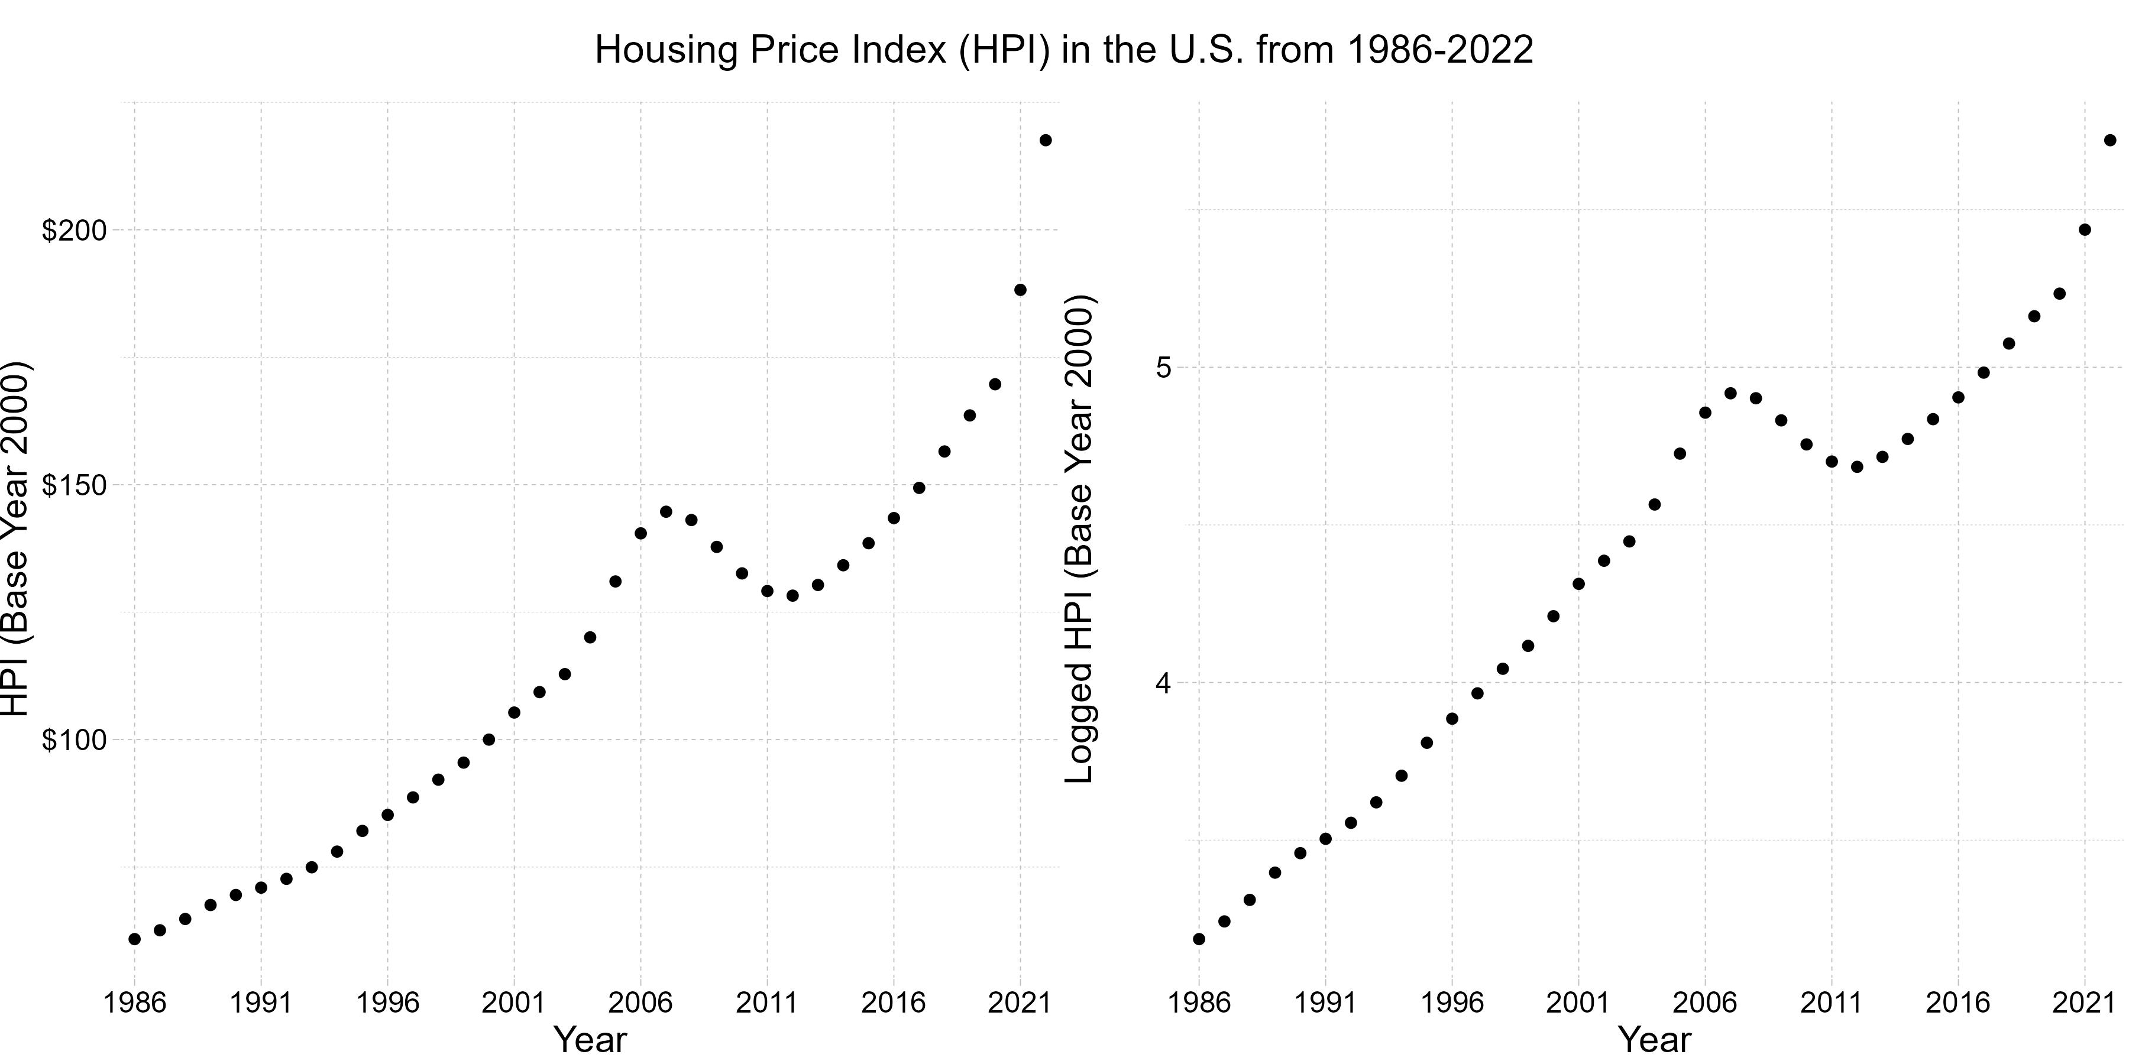
Finding #1: HPI increases, decreases, and increases again as time goes on

Slide 7
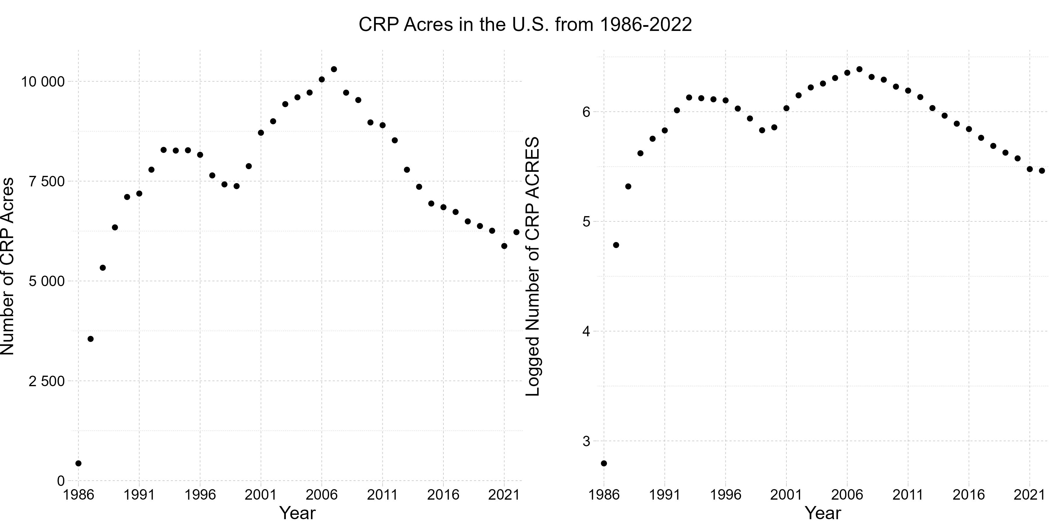
Finding #2 - CRP acres increase, decrease, increase, then decrease again as time goes on

Slide 8
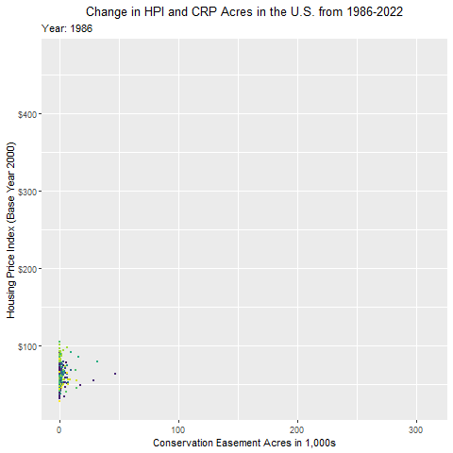
Finding #3 - The spread of CRP acres and HPI increase as time goes on

Slide 9
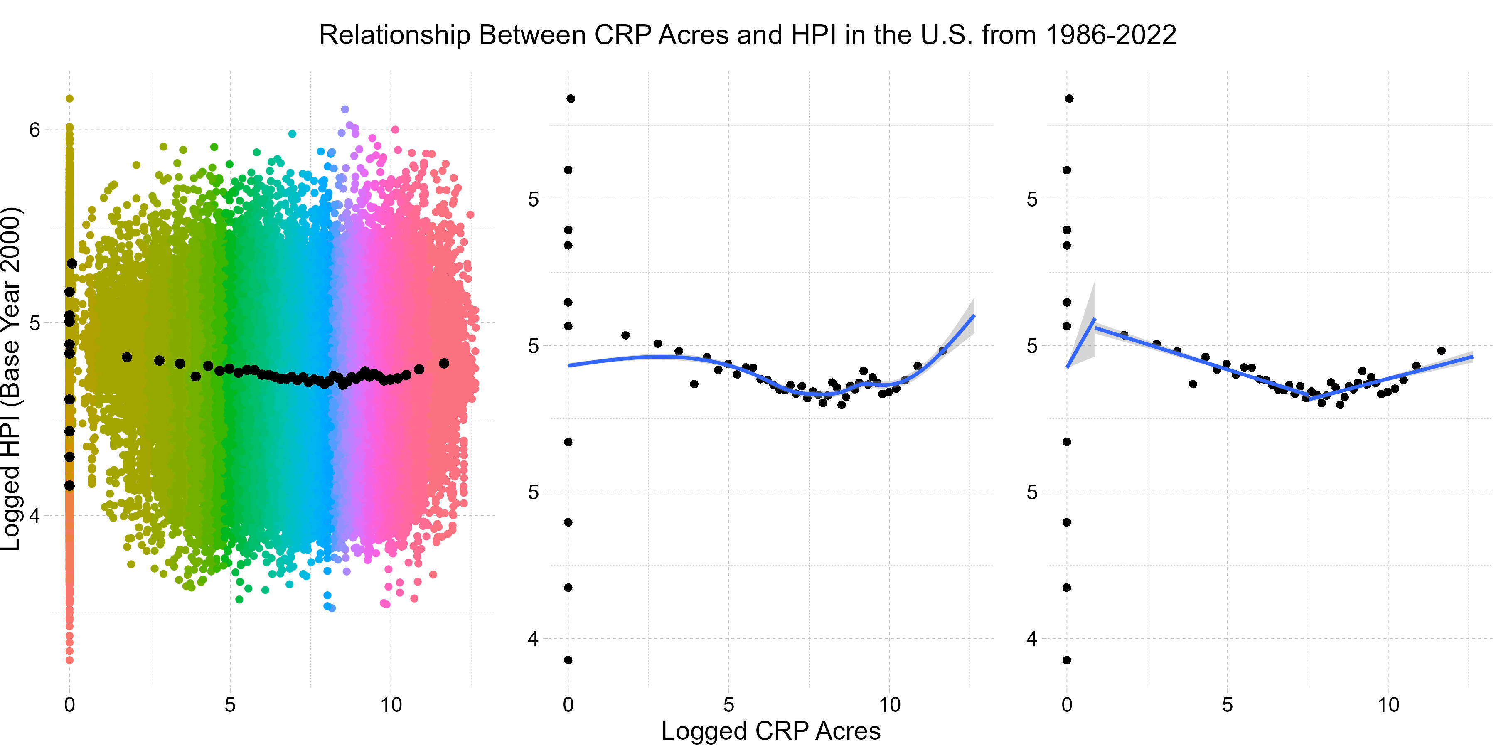
Finding #4 - There is a weak relationship between CRP and HPI. Non-linear estimation suits the data better than linear

Slide 10
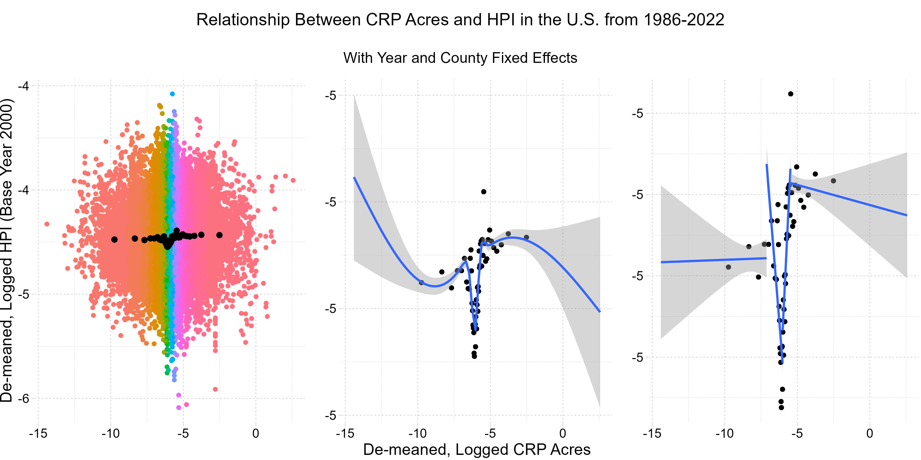
Finding #4 - There is a weak relationship between CRP and HPI. Non-linear estimation suits the data better than linear

Slide 11
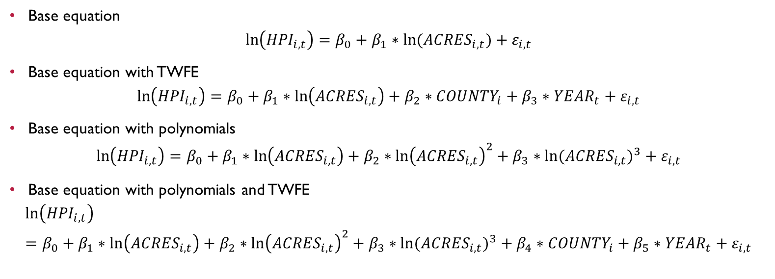
Econometric Analysis
Base equation
$$\ln\left({HPI}_{i,t}\right)=β_{0}+β_{1}∗ln⁡({ACRES}_{i,t})+ε_{i,t}$$
Base equation with TWFE
$$\ln\left({HPI}_{i,t}\right)=β_{0}+β_{1}∗\ln\left({ACRES}_{i,t}\right)+β_{2}∗{COUNTY}_{i}+β_{3}∗{YEAR}_{t}+ε_{i,t}$$
Base equation with polynomials
$$\ln\left({HPI}_{i,t}\right)=β_{0}+β_{1}∗\ln\left({ACRES}_{i,t}\right)+β_{2}∗{\ln\left({ACRES}_{i,t}\right)}^{2}+β_{3}∗{ln⁡({ACRES}_{i,t})}^{3}+ε_{i,t}$$
Base equation with polynomials and TWFE
$$\ln\left({HPI}_{i,t}\right)=β_{0}+β_{1}∗\ln\left({ACRES}_{i,t}\right)+β_{2}∗{\ln\left({ACRES}_{i,t}\right)}^{2}+β_{3}∗{ln⁡({ACRES}_{i,t})}^{3}+β_{4}∗{COUNTY}_{i}+β_{5}∗{YEAR}_{t}+ε_{i,t}$$

Slide 12
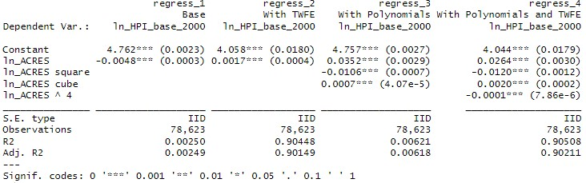
Econometric Analysis Results

Slide 13
Econometric Analysis Findings
Change in CRP acres appear to have a very small effect on HPI
All calculated coefficients of interest are statistically significant at the 0.001 level
The very small effects are either positive or negative depending on formula
The two models with fixed effects, regressions 2 and 4, explain much more of the variation in the data set than the regressions without fixed effects, models 1 and 3.
R-squared values jump from about 0.002 → 0.006 to 0.904 → 0.905.
Adding the quartic polynomials does not affect R-squared very much

Slide 14
Econometric Analysis Limitations
Some counties never reported CRP acreage
Omitted variables bias – something that affects both CRP acreage and HPI, and that changes within units rather than across units
Economic growth/decline
Population growth/decline
Environmental changes/natural disasters

